Slide 1
Machine Learning Applications to Blending Challenges
LSST2019 PCW Breakout
Wednesday, August 14, 2019, 1:30-3:00pm Pacific
Coronado II
Bluejeans meeting ID: 835 141 188

Slide 2
Goals for today’s session:
Make the session useful for a broad set of participants.
Establish some common terminology and definitions.
Quick overview of ~ten ongoing projects:
using machine learning to address blending challenges (detecting, identifying, deblending, or measuring blended objects).
tools for training & testing algorithms, including performance metrics; potential for ML applications in image generation.
Perspective from LSST DM (Jim Bosch, science pipelines).
Identification and discussion of promising approaches and common issues that could be explored or addressed more effectively across science collaborations.
Notes:
Introduction: Goals + terminology 4 minutes; ML overview 6 minutes. => 10 min
Quick project overviews: 10 * (2min + 1min) => 30 min
View from DM + discussion: 10 + 10 => 20 min
Common issues, opportunities + discussion: 10 + 10 => 20 min
=> ~ 80 min

Slide 3
Some Terminology *
blended: two or more objects are close enough that we can't accurately measure them independently.
detection: given images of a patch of sky, return above-threshold regions and the rough positions of objects within them.
deblending (1): given images and the rough positions of blended objects, construct images or models that separate their flux so they can be measured separately.
deblending (2): both detection and deblending (1)
measurement: estimate size, shape, flux, … from pixels.
* Jim Bosch, Workshop on Impacts of Blending on LSST Science, LSST P&CW 2018
Notes:
Pat

Slide 4
Some Terminology
Could be
iterative
detection
deblending
measurement
Could be simultaneous
Notes:
Pat

Slide 5
Possible outcomes of detection for a pair of objects
colored shading = truth, dashed outline = detected & measured
A only
B only
A + B
shredded
blend
2
0
3
recognized blend
2
0
2
unrecognized blend
2
0
1
undetected blend
1
1
1
merged
blend
0
2
1
# detected separately: # UNdetected separately: # detected in blend:
Notes:
Pat
This slide is animated.

Slide 6
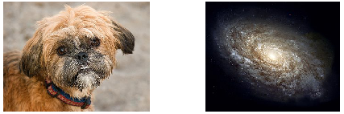
Astro Data vs. Natural Images
ML algorithms designed for natural images generally do not account for the differences. For example, for astro data,
Individual objects are small and have relatively simple shapes.
Objects have diffuse (and ~transparent) edges.
Images are often captured with low (known) signal-to-noise ratio.
Background pixels are ~0 (after sky subtraction) and foreground >~ background.
All objects at ~infinity, with no depth-of-field blurring.
>3 filter bands often available but recorded under different conditions.
Uncertainties are often desirable for downstream analysis.
Can often simulate our data to generate large datasets with truth labels.
Notes:
David

Slide 7
Computer Vision
Supervised
Un-supervised
Generative
Probabilistic
MC Dropout
Sem. Seg.
Mask R-CNN
Detection
Probabilistic Detection of Blends
Morphological Classification
Detecting Unrecognized Blends from Residuals
PixelCNN
GAN
VAE
Morphology
Probability
Prior / Regul.
Deblending
Deblending with Branched GANs
Deblending
with VAE
U-Net
Measurement
Photometry on Blended Galaxies
Infrastructure
Blending ToolKit
Notes:
David
Projects added since Paris DESC mtg do not appear here

Slide 8
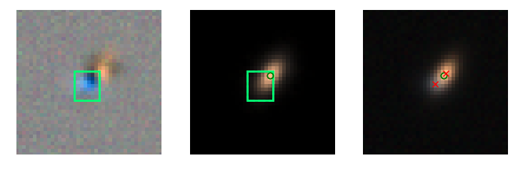
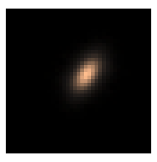
Detecting unrecognized blends from residuals.
Sowmya Kamath & Pat Burchat
Challenge: detection of unrecognized blended objects at 10-year LSST depth
Algorithm: modification of Mask R-CNN*, iterativley used with LSST Science Pipeline
Training / test sets:
CatSim, Weak Lensing Deblending Package, BlendingToolKit
Six LSST bands; single 10-year LSST depth exposure per band.
Parametric bulge+disk galaxy images with Poisson pixel noise; between one and six galaxies per blend.
Postage stamp not centered on a single object.
Same PSF for entire dataset.
Metrics: Detection efficiency as a function of magnitude, size, distance to nearest neighbor.
Current issues: for training, creating galaxy images with more complex (realistic) morphologies; defining performance metrics in a complex multi-dimensional space.
Current status: Preliminary results; detection efficiency improved with ‘minimal’ shredding + false decections.
DESC Blending Task Force (BTF) presentations - all public: Mask R-CNN case study (July 2018), prelim. results (June 2019). Also see github.
* Mask Region-based Convolutional Neural Network, Facebook AI Research Detectron codebase for object detection research.
Back to index
Notes:
Sowmya/Pat
Mask Region-based Convolutional Neural Network (Mask R-CNN) implemented in the Facebook AI Research Detectron codebase for object detection research (https://github.com/facebookresearch/detectron)

Slide 9
Probabilistic Detection of Blends
Noble Kennamer & David Kirkby
Challenge: Detection (and eventually measurement).
Algorithm: Pixels in; relative probabilities of 0,1,2,... objects out. Approximate Bayesian ANN (Resnet-18) using MC-Dropout.
Training / test sets:
Train and test with GalSim generated postage stamps containing 0-few sources.
Single band, single exposure, SNR ~ LSST 30 sec.
Fluxes, sizes, shapes drawn from simple parameterized models (for now). Objects not centered.
Metrics: how well calibrated are the output probabilities?
Current issues: How best to represent results of probabilistic detection (and measurement).
Current status: Getting reasonable results for detection only. Investigating now how to combine detection and measurement in probabilistic framework.
Relevant links: Uncertainty2019 CVRP Workshop
Back to index
Notes:
David
Metrics: Calibration and uncertainty estimates as observing conditions vary
Current Issues: Techniques to recover from underestimated uncertainty from approximate bayesian techniques.

Slide 10
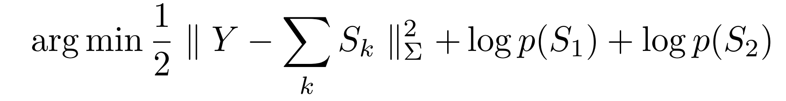
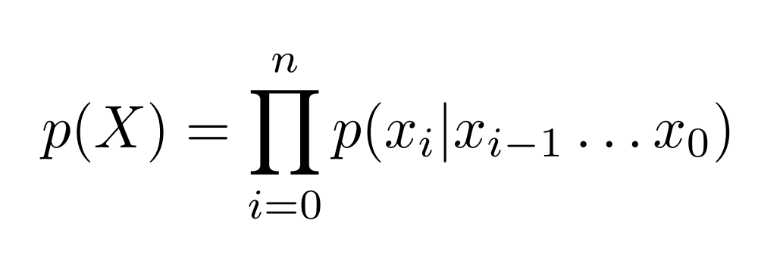
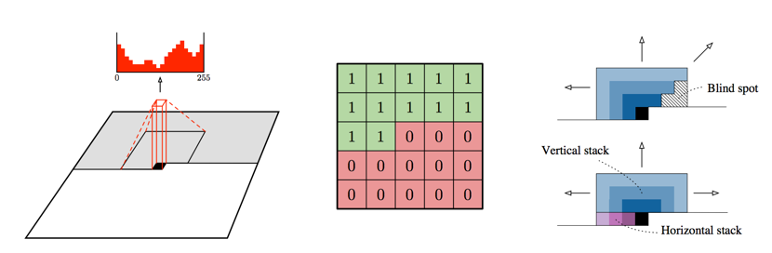
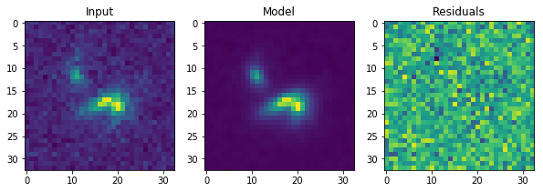
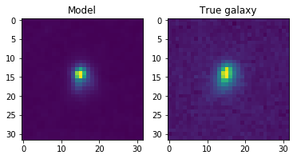
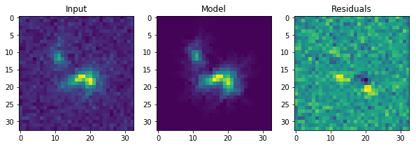
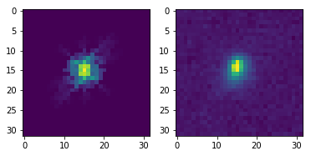
Deep learning as a regularisation for deblending
François Lanusse
Peter Melchior
Challenge: How do we regularise a deblending problem expressed as a linear inverse problem so that solutions look like galaxies?
Algorithm: Auto-regressive generative models give access to the joint pixel probability of an image:
By using masked convolutions
This estimation of the likelihood of a morphology can be used in
Scarlet to replace the monotonicity and symmetry operators as constraints on morphologies of galaxies.
Credit: van den Oord et al. 2016
Slides
PixelCNN scarlet
Vanilla Scarlet: monotonicity and symmetry constraints
Back to index
Notes:
Peter

Slide 11
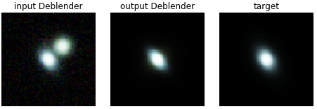
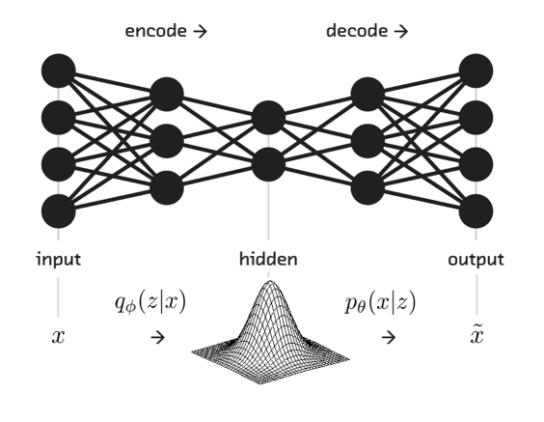
Deblending galaxies with Variational Autoencoder
Bastien Arcelin Cyrille Doux Cécile Roucelle Eric Aubourg
Challenge: probabilistic deblending of galaxies
Algorithm: 2 CNN Variational AutoEncoder (VAE, Kingma 2014) 1st prior on single galaxies, 2nd as deblender with fixed decoder.
Training / test sets:
Images generated with GalSim from COSMOS catalog
6 LSST band, 100 stacked exposures, centered images (+4 of Euclid),
Includes noise, varying LSST PSF (dist from science book), 1 to 4 objects per image, centered on brightest
Metrics: reproduction of shape+flux (output vs target), as function of distance, mag difference
Current issues: Optimizing architecture and defining performance metrics
Current status: Preliminary results: VAE under validation, deblender in training
Relevant links: BTF presentation(s): July 2018, May 2019 (update)
Back to index
Notes:
Bastien

Slide 12
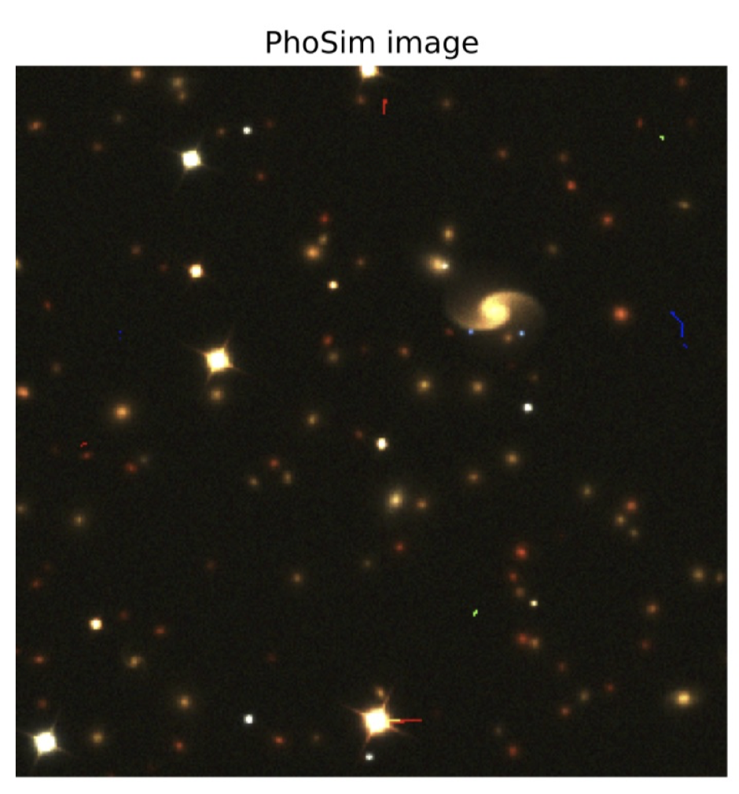
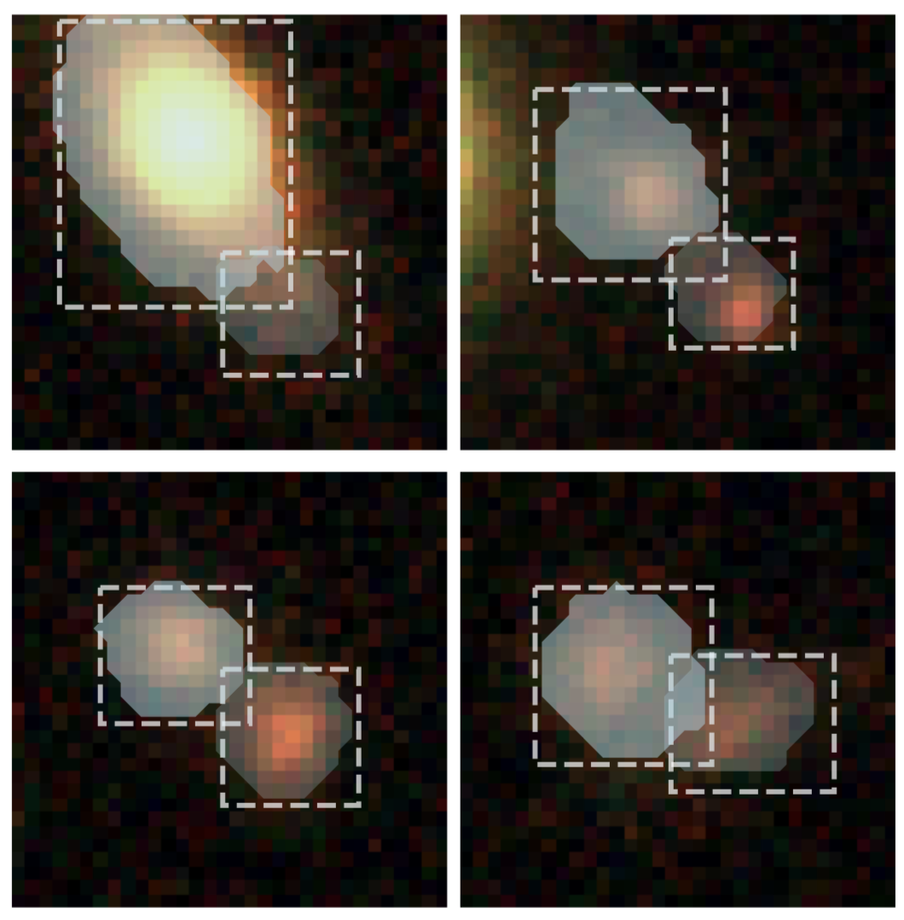
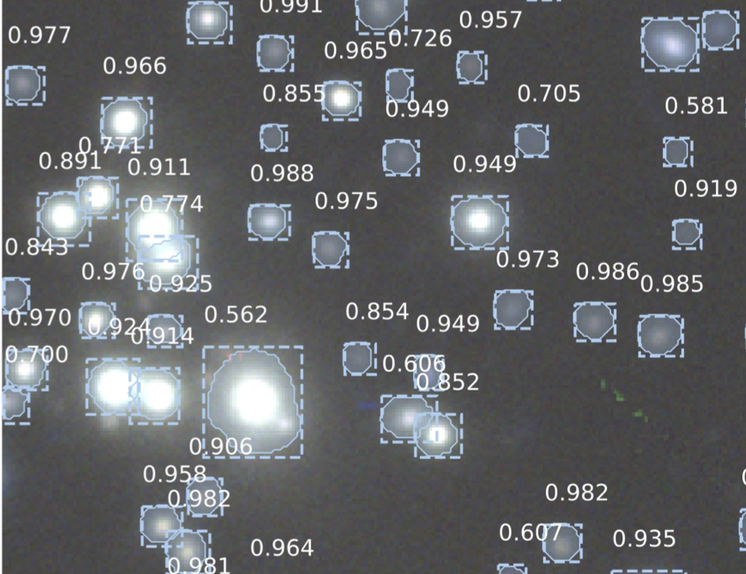
Detecting+Classifying+Deblending with Mask R-CNN
Colin J. Burke,
Patrick D. Aleo et al.
Challenge: detecting, classifying, deblending stars and galaxies in realistic multi-band scenes
Algorithm: Mask R-CNN for object detection and segmentation
Training / test sets -- Dark Energy Camera (DECam) images:
512x512 PhoSim images, using its built-in catalog generator, modified to output masks
120-sec g,r,z DECam exposures (g < 23); testing inference with full-depth LSST-like (g < 28) & real images not in training set
Training set image realism: random catalog+observational conditions, varying seeing and background, galaxy SEDs + ellipsoidal Sersic for bulge & disk, cosmic rays
PhoSim training image
Inference
DECaLs image inference
Metrics: Purity (precision)-completeness (recall) curves against ground truth simulated images. AP score (area under this curve) for varied IOU (degree of truth/det. masks overlapping) thresholds on test dataset
Current issues: Use w/ full-scale CCD images; hard to extend to scenarios outside of training set; mask geometry not tied directly to a measurement
Current status: Paper submitted to MNRAS; preprint on arXiv
Relevant links: https://github.com/burke86/astro_rcnn; arXiv190802748
Notes:
Colin, Patrick (on BlueJeans)

Slide 13
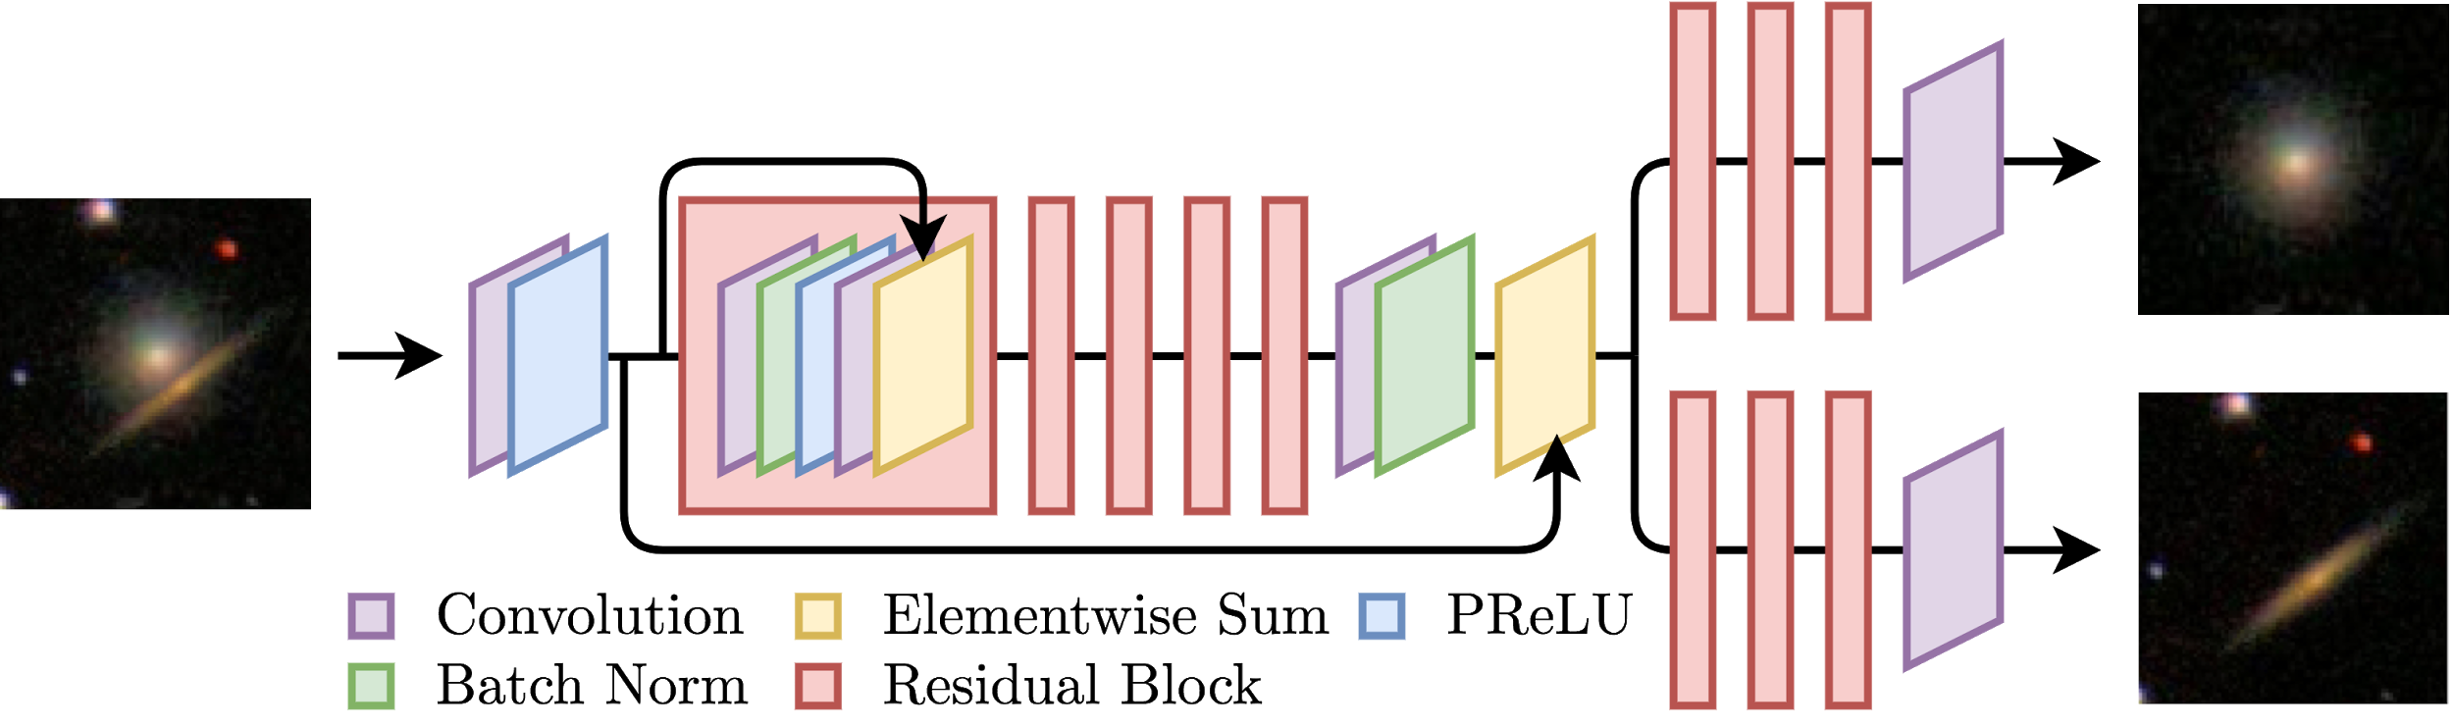
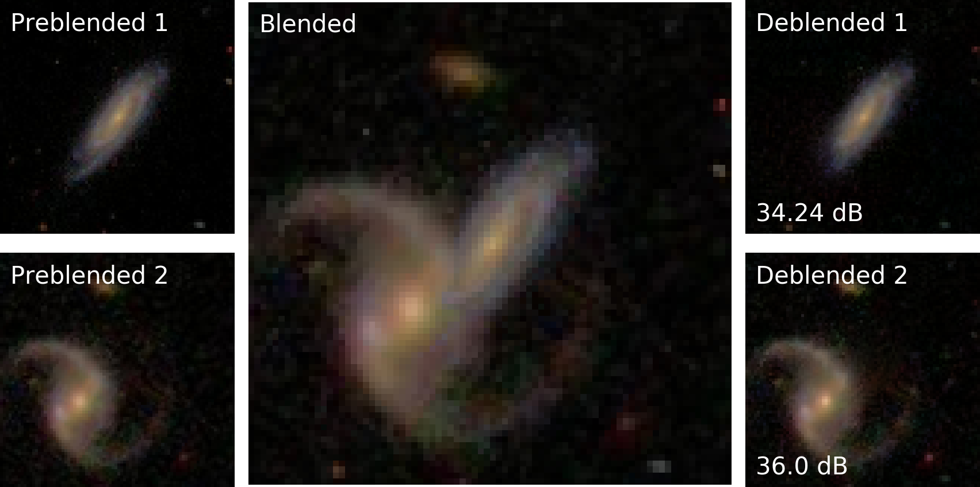
Deblending galaxy superpositions with branched GANs
David Reiman & Brett Gohre
Challenge: deblending
Algorithm: Branched generative adversarial network with compound loss
Adversarial loss: discriminative loss term which captures global coherence and ensures deblended galaxies appear to be a likely draw from the distribution over real galaxy images
Content loss: pixelwise loss (mean squared error) to ensure deblended images appear similar to their pre-blended counterparts
Training / test sets:
Simulated blends with images from SDSS via Galaxy Zoo
Multi-band (g, r and i), 8 bits/channel
Non-centered objects, rotational/translational/scaling augmentation
Metrics: Pixelwise image similarity via peak signal-to-noise ratio (PSNR) and structural similarity (SSIM)
Current issues: Finite number of branches, GAN mode collapse (low diversity), simulated blend method
Current status: Paper submitted and accepted to MNRAS
Relevant links: Feb 4 & Feb 11 2019 BTF presentations, arXiv:1810.10098, Github: https://github.com/davidreiman/deblender
Back to index
Notes:
David
Feb 11, 2019 - David Reiman (presenter) & Brett Gohre, Deblending galaxy superpositions with branched generative adversarial networks – Part II: the paper (https://arxiv.org/abs/1810.10098)
Feb 4, 2019 - David Reiman, Deblending galaxy superpositions with branched generative adversarial networks – Part I: Introduction to CNNs and adversarial networks.

Slide 14
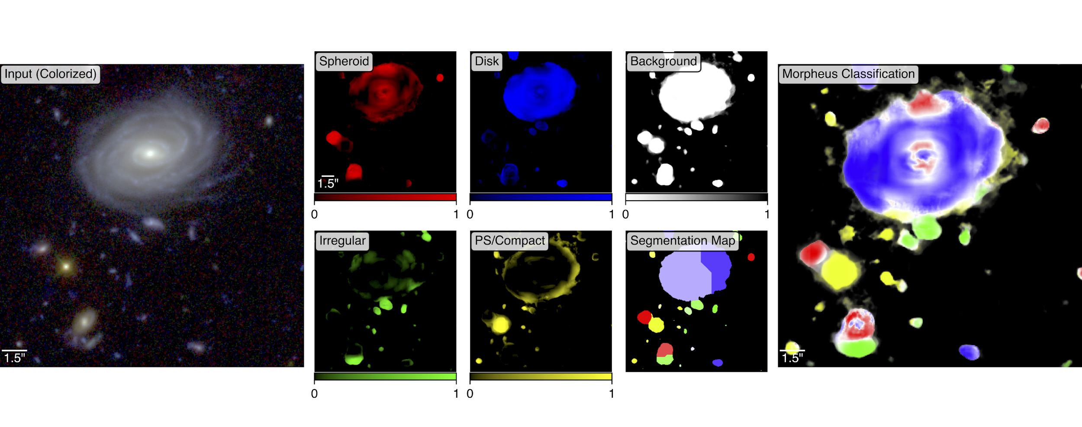
Morpheus: Pixel-Level Morphological Classifications
Ryan Hausen,
Brant Robertson
Challenge: Detection and measurement, with applications to deblending
Algorithm: Morpheus -- a semantic segmentation framework for pixel-level classification of astronomical images based on deep convolutional neural networks.
Training / test sets: Trained and tested on Kartaltepe et al. 2015 visual classifications of CANDELS HST images (~7K objects) w/ augmentation (~>500k). Morpheus operates directly on science-quality multiband FITS images.
Metrics: Classification accuracy, intersection over union of generated segmentation maps, detection efficiency vs. SNR, false negative and false positive detection tests.
Back to index
Current issues: Application to other datasets (incl. ground-based), pixel-level classifications beyond morphology (e.g., photo-z), improve ad hoc deblending scheme and extend to include morphological deblending.
Current status: Methods paper submitted to ApJ (arXiv:1906.11248), code released publicly. Pixel-level morphological classifications of CANDELS GOODS S and value-added catalog of 3DHST sources released.
Relevant links: March 2019 BTF presentation, arXiv:1906.11248, https://morpheus-project.github.io/morpheus/
Notes:
David
March 4, 2019 - Ryan Hausen (presenter) & Brant Robertson – Morpheus: A Model For Pixel-Level Morphological Classification.
Paper: https://arxiv.org/abs/1906.11248

Slide 15
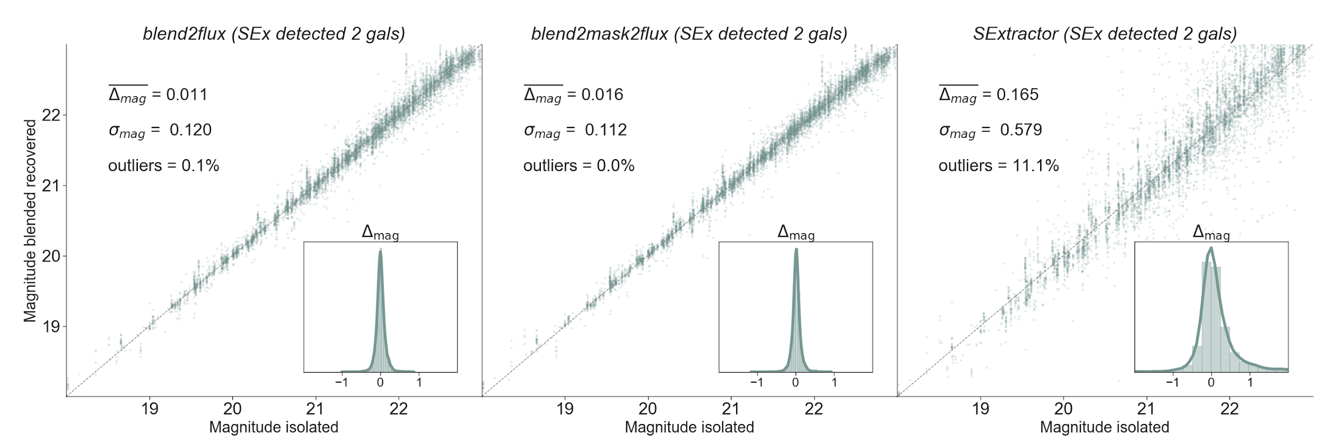
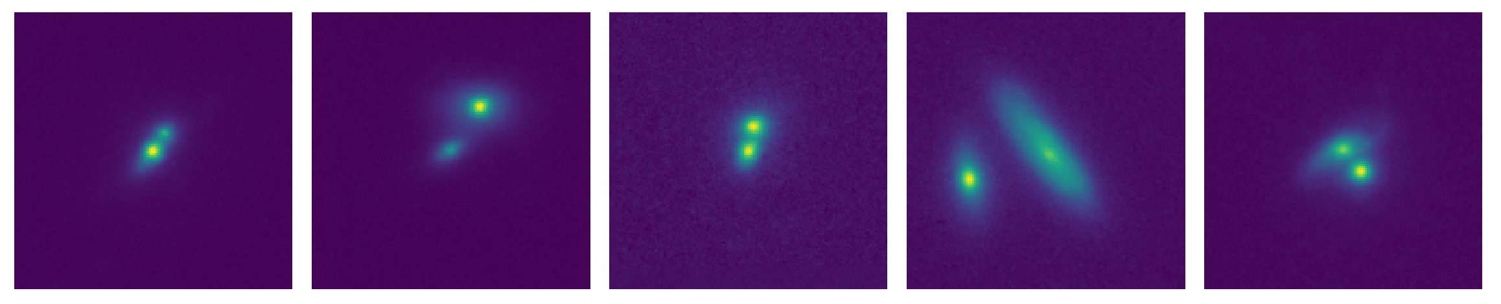
Photometry on blended galaxies
Alexandre Boucaud
Marc Huertas-Company
Emille Ishida
Challenge: Deblending & photometry
Algorithm: modified U-Net and classic CNNs
Training / test sets:
single-band galaxies
homemade blend stamps using summation and real CANDELS galaxies
real galaxies with 18 < mag < 24 and various morphologies, including irregulars.
Metrics: mask reconstruction efficiency using Jaccard index (a.k.a. IoU) w.r.t. SExtractor segmap
and percentage error on the recovered magnitude, again w.r.t SExtractor magnitude.
Current issues: limitations of current state: restricted to galaxy pairs, one galaxy always centered, cannot be applied without prior detection on blend.
Current status: paper submitted to MNRAS (1905.01324), PhD student starting in September to follow up on the work (multi-band, multiple galaxies, etc.)
Relevant links: github:candels-blender, March 2019 BTF presentation, arXiv:1905.01324
Back to index
Notes:
David?

Slide 16
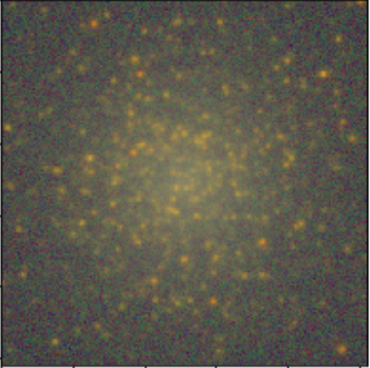
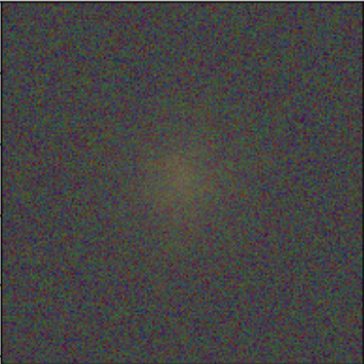
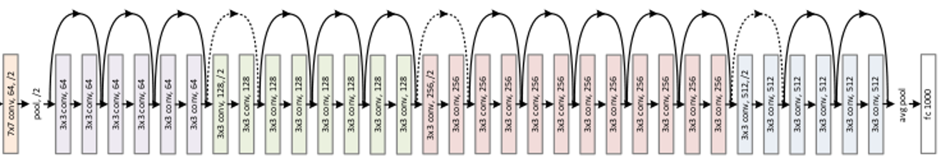
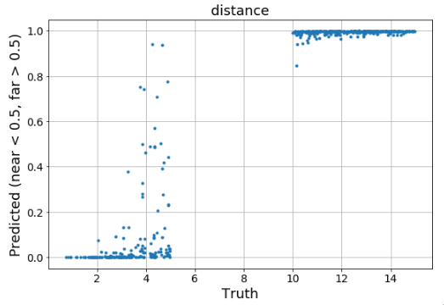
CNN: Identification of semi-resolved dwarf galaxies
Harry Ferguson
Craig Jones
Robel Geda
Erik Tollerud
Challenge: Identify dwarf galaxies and estimate distances (<~ 20 Mpc)
Algorithm: Convolutional neural network created and trained for near / far distance
Second CNN trained for quantifying parameters from simulated images
Training / test sets:
12,000 images were simulated drawing from realistic distributions of:
Distance, Log(M*), radius, axial ratio, Fe/H, age
Semi-realistic HSC g,r,i,z,y images in terms of PSF variation & noise
Metrics: Categorical near/far, Regression: distance, log(M*), FeH
Current issues: Create an appropriate sample, optimize the CNN
Current status: Retraining with simpler training set
More uniform in distance, log(M*), PSF & noise
4 Mpc
16 Mpc
2
Notes:
Harry

Slide 17
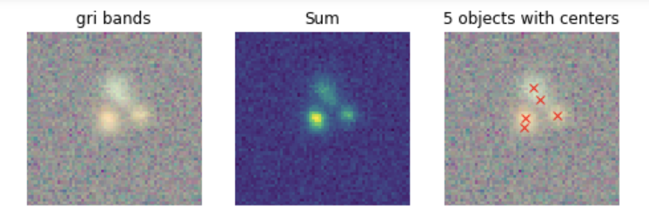
BlendingToolKit
BTK developers:
Sowmya++
Challenge: training, testing and comparing different detection, deblending and/or measurement algorithms with a consistent set of images and performance metrics.
Training / test sets:
Currently CatSim catalog + images produced with Weak Lensing Deblending Package and GalSim.
Can generate multi-band LSST (or other survey) images at defined exposure times with sky noise.
Parametric bulge+disk galaxy images.
On-the-fly image generation, data augmentation, multiple noise realizations.
Metrics: Detection efficiency as a function of magnitude, size, distance to nearest neighbor.
Current issues:
Incorporate more datasets: complex morphology, real galaxies, generated images (GAN, VAE)
Complex space for defining detection, deblending and measurement metrics.
Current status: Used for study of detection of unrecognized blends. Collaborators / contributors very, very welcome!
Relevant links: github, BTF presentation (Jan 2019) slides
Back to index
Notes:
Sowmya, Pat

Slide 18
For completeness -- other work we’re aware of:
Maxime Paillassa, Emanuel Bertin, Hervé Bouy
Presentation at Workshop on Deblending with Deep Learning (Indico), France, June 2017: “Deblending in crowded star fields using convolutional neural networks”
arXiv:1907.08298: “MaxiMask and MaxiTrack: two new tools for identifying contaminants in astronomical images using convolutional neural networks”
Rémy Joseph et al.
arXiv:1603.00473: Multi-band morpho-Spectral Component Analysis Deblending Tool (MuSCADeT): Deblending colourful objects, R. Joseph, F. Courbin, J.-L. Starck
Marc Huertas-Company
Generating more realistic models of galaxy morphology, knots, …
Notes:
Pat

Slide 19
Perspective from LSST Data Management
Jim Bosch
Science Pipelines
We are not expecting any machine-learning approaches to deblending to be mature enough to be included in the DM pipelines for DR1.
We'd be happy to be proven wrong.
We do think machine learning may have a big role to play in deblending later in LSST operations.
Contact us directly if you think you have something that is ready, or want to talk about how to get it there - we (I) have a hard time keeping up with all of the developments in this field.
Notes:
Jim

Slide 20
What makes an algorithm pipeline-ready
Jim Bosch
Science Pipelines
Robustness: we need algorithms that can handle garbage input without catastrophic failure (e.g. crashing, huge slowdowns, downstream measurements that are worse than if we had not tried to deblend at all).
Performance: we (now) expect to spend a lot of our compute budget deblending, but we still need algorithms that are of order 1s/object, and they should scale at worst N log N with the number of pixels or number of objects (not their product).
Uniformity: we need something that performs about the same in all conditions, accounting for loss of information - if your training embeds a particular PSF size assumption, for example, that's a problem.
Battle-testing: we want the above to have been demonstrated by running on significant quantities of real data.
Notes:
Jim

Slide 21
We want to be weakly Bayesian
Jim Bosch
Science Pipelines
Whenever possible, DM tries to report likelihoods, not posteriors, so downstream scientists can apply their own priors.
This probably isn't strictly possible in deblending, but we want any priors/training to be as weakly informative as possible, to minimize unrecoverable biases in downstream science.
It is more important for a measurement to be simple/understandable than optimal for any particular science case.
Controlling systematics means understanding selection functions and projecting what our measurements would have done with arbitrary objects of interest. The easier it is to do those things, the better.
Notes:
Jim

Slide 22
Common Issues: Data
There is a limited amount of suitable (real) data available in area x filters x depth.
GAN
SDSS:
Deblending with Branched GANs
HSC:
?
Sem. Seg.
U-Net
PixelCNN
CANDELS:
Morphological Classification
Photometry on Blended Galaxies
COSMOS:
Morphology
Probability
Prior / Regul.
MC Dropout
Mask R-CNN
VAE
GalSim (WLD):
Probabilistic Detection of Blends
Detecting Unrecognized Blends from Residuals
Deblending
with VAE
Injection:
?
Back to index
Notes:
David

Slide 23
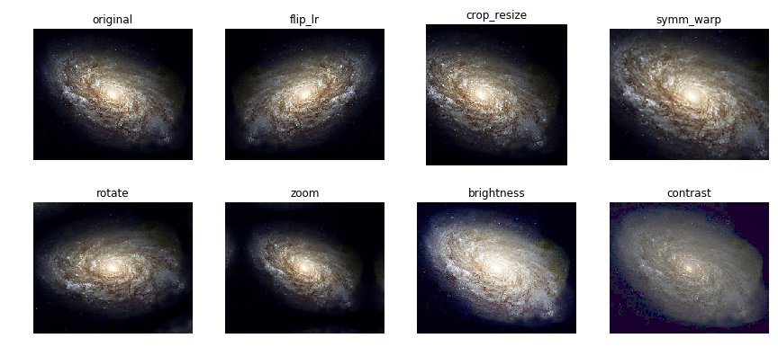
Common Issues: ML
Postage stamps vs "scenes".
Center stamps on detected objects?
Use of inverse variance weights? extra channel vs L2 loss.
Image preprocessing to capture dynamic range and normalize.
Data augmentations.
Notes:
David

Slide 24
Opportunities
Blending challenges:
Photo-z inference for blended sources.
Simultaneous deblending & measurement.
ML techniques:
Semi-supervised learning (ground + space, photom. + spectro., vis. + IR)
Transfer learning (reusable building blocks)
Denoising (de-crapification)
Notes:
David

Slide 25
LSST DESC Blending Task Force discussions of ML (reverse chronological order)
Titles are linked to internal DESC confluence site; where available, public links are included at end.
Update: Detecting unrecognized blends with CNNs: training & testing on multi-object blends; comparison of metrics for different methods, Sowmya Kamath, 06/03/19. [slides]
Update: Deblending galaxies with Variational Autoencoder (VAE): a multi-band, multi-instrument analysis, Bastien Arcelin, 05/28/19.
Update: Detecting unrecognized blends with CNNs: update and performance comparison, Sowmya Kamath, 04/29/19. [slides]
Deep Morphology Priors for Deblending, aka SCARLET meets Deep Learning, Francoise Lanusse, 04/15/19. [slides]
Photometry of blended galaxies with deep neural networks, Alexandre Boucaud, Marc Huertas-Company, Emille Ishida, 03/25/19. [arXiv:1905.01324]
Morpheus: A Model For Pixel-Level Morphological Classification, Ryan Hausen & Brant Robertson, 03/04/19.
Deblending galaxy superpositions with branched generative adversarial networks, David Reiman & Brett Gohre, 02/11/19. [arXiv:1810.10098]
Colour and morphology deblending of galaxies with sparse representation, Rémy Joseph, 01/28/19. [slides]
Blending Tool Kit status, updates and applications, Sowmya Kamath, Francois Lanusse, 01/07/19. [slides SK, slides FL]
Addressing blending challenges with neural networks – A case study: Mask R-CNN, Sowmya Kamath, 07/02/18 + 07/24/18 @ CMU. [slides]
Deblending galaxies with deep, convolutional, probabilistic neural networks, Cyrille Doux, 07/02/18 + 07/24/18 @ CMU.
Deep generative models for modeling galaxy morphologies, Francois Lanusse, 07/24/18 @ CMU (2nd talk in slides). [arXiv:1609.05796]
Generative Models for simulations overview, LSST2018 Blending Workshop. [slides]
Convolutional neural networks and independent component analysis of multi-filter imaging data, part I, part II, Laurence Perreault Levasseur, Yashar Hezaveh, 12/18/17, 01/29/18. [arXiv:1708.08842, arXiv:1708.08843]
Notes:
For reference only.

